Slide 1




Data Analysis
on
TMDB Movie data
By Subhadwip manna
Under guidance of Dr. Aakansha Gupta

Slide 2



Introduction
The production company wants to analyze a movie dataset to understand the factors that contribute to commercial success and high ratings. By examining patterns and trends in the data, the company hopes to identify which genres tend to perform well at the box office and other key drivers of success. This knowledge can be used to predict the performance of future movies and inform decisions around production strategies. Ultimately, the goal is to increase the likelihood of creating hit movies by taking a data-driven approach to understanding audience preferences and behavior.
Here we have to use python programming to analyze the data to perform exploratory data analysis by answering the questions in the upcoming slides.

Slide 3

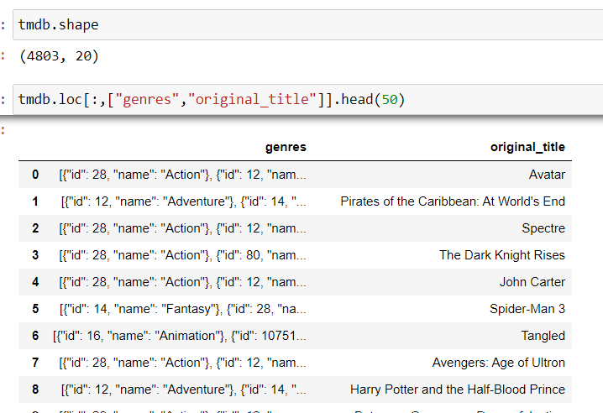
Number of rows : 4803
Number of Columns: 20

Slide 4

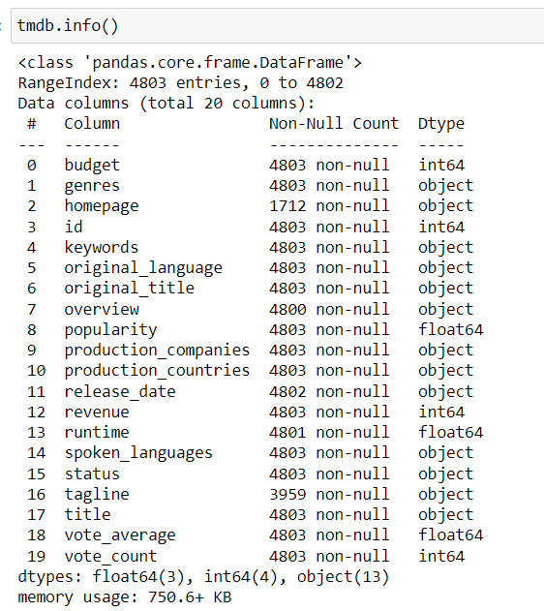
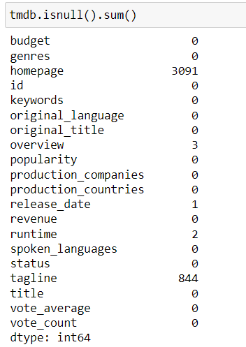

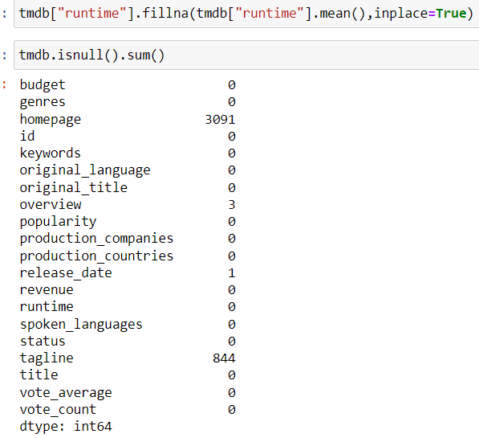
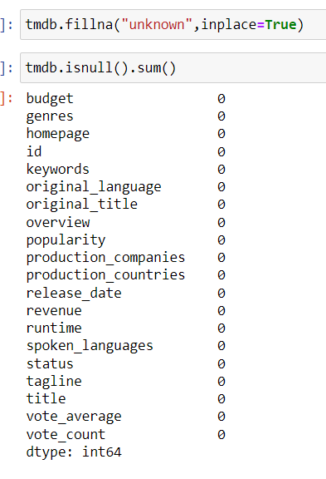
Treatment: 1.null values in runtime column by avg
runtime
2. Rest all columns having null replaced
by a word “unknown”

Slide 5
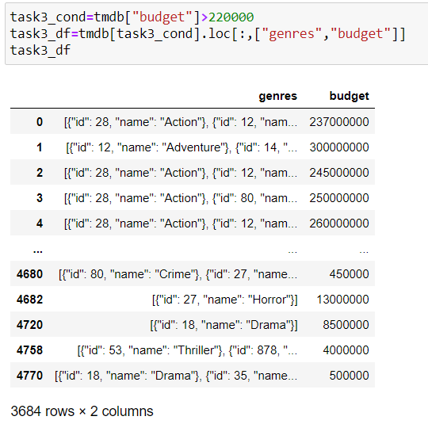

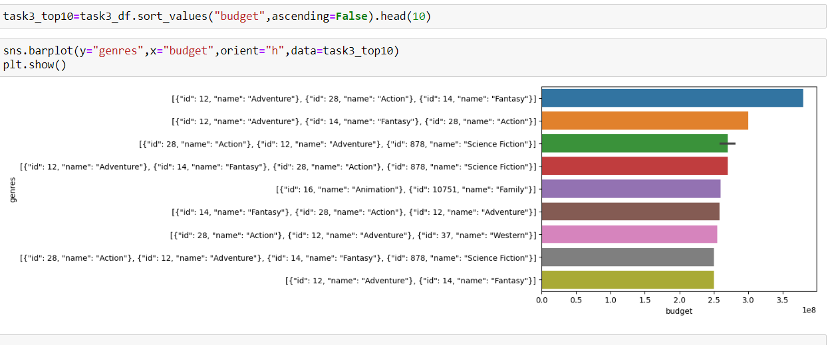

Number of records : 3684

Slide 6

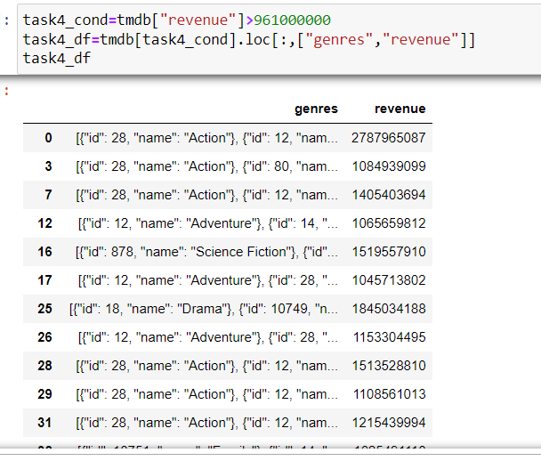
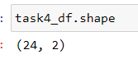
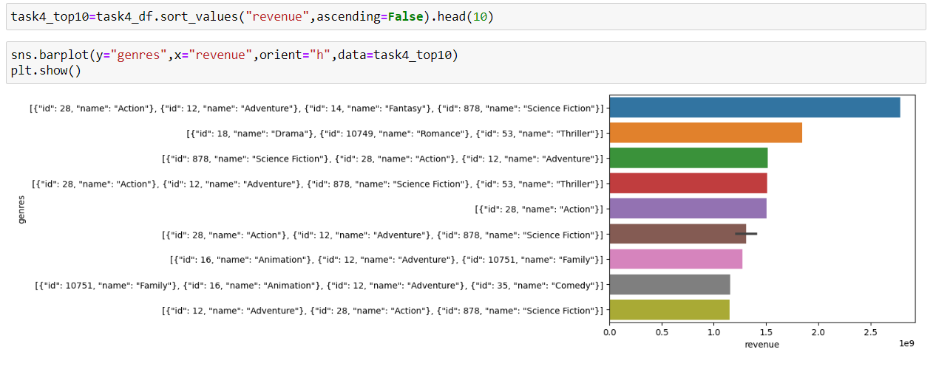

Number of records : 24

Slide 7
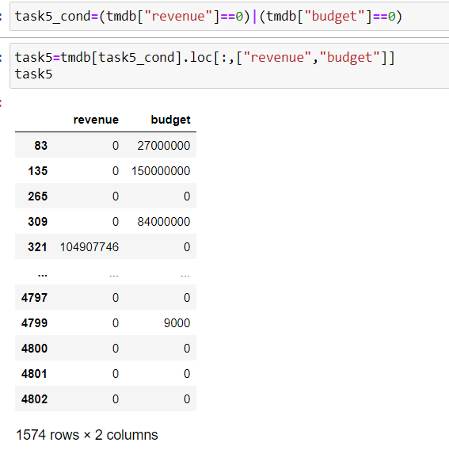
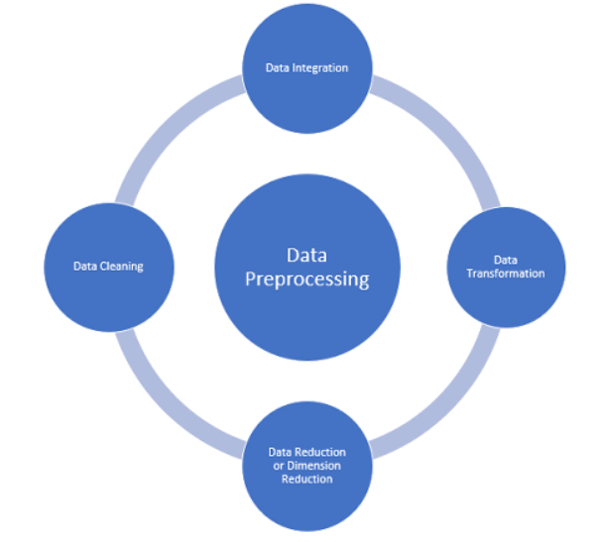
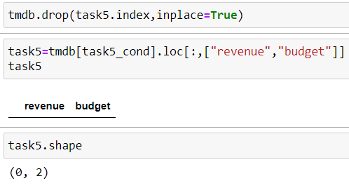

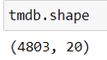
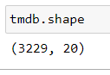
Treating 0 value :
Number of records : 0
Before treatment
After treatment
Number of records : 1574

Slide 8

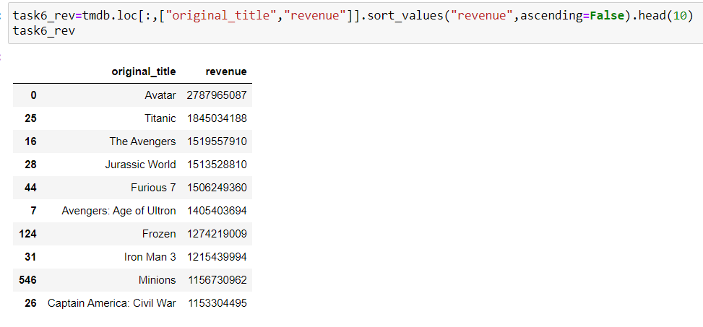
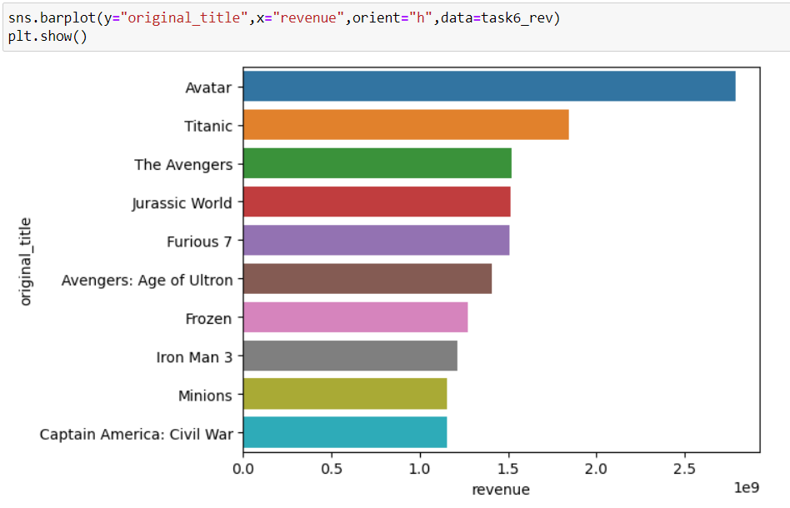


Slide 9

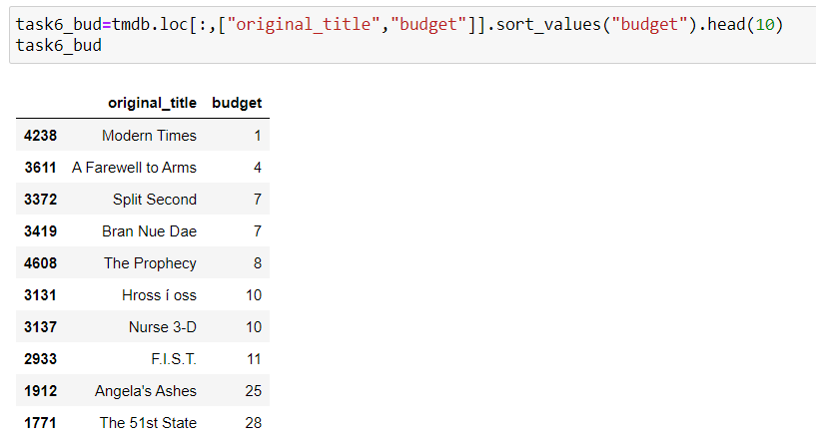
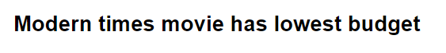
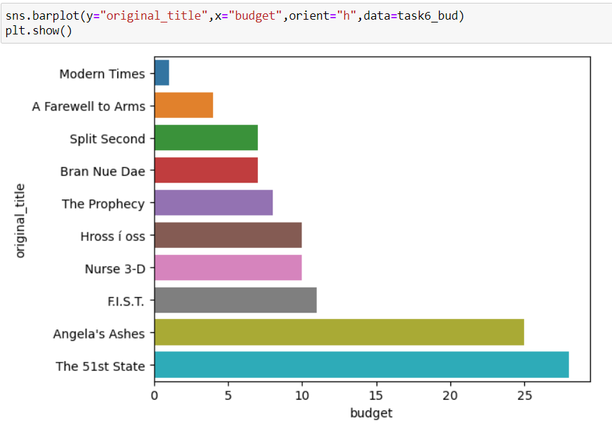


Slide 10

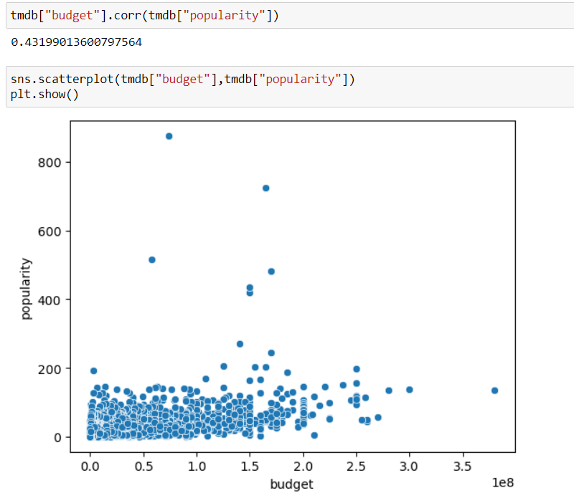


Slide 11

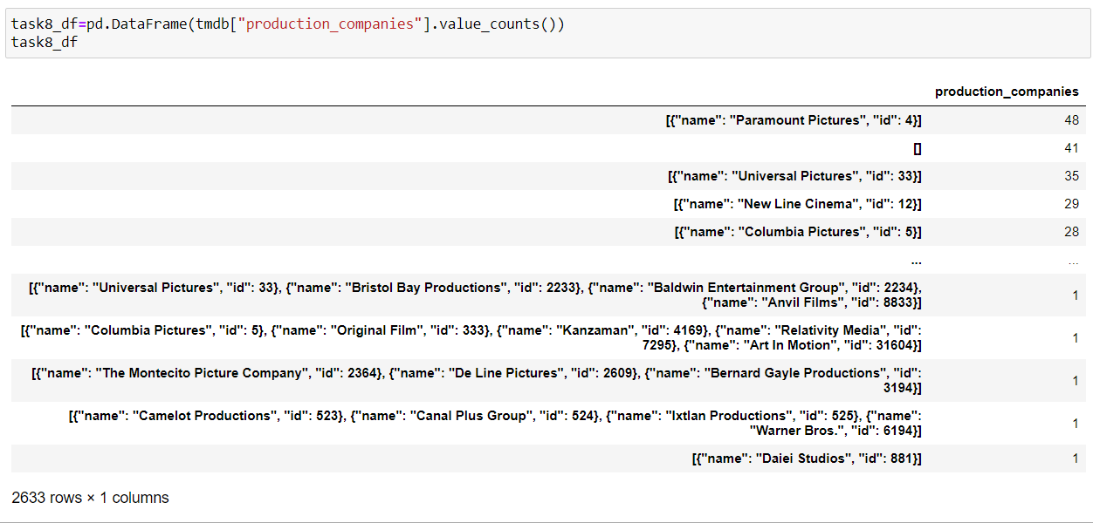


Number of records : 2633

Slide 12
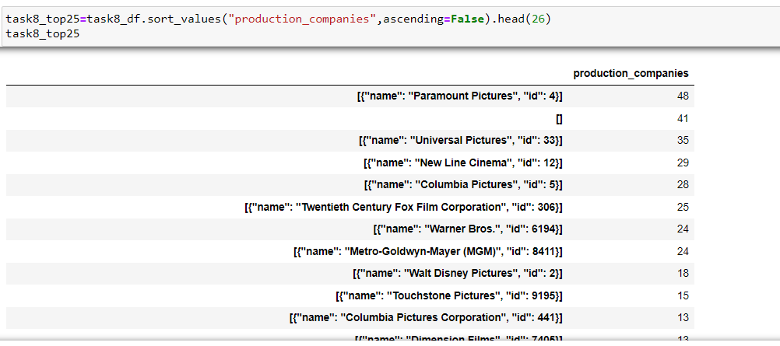
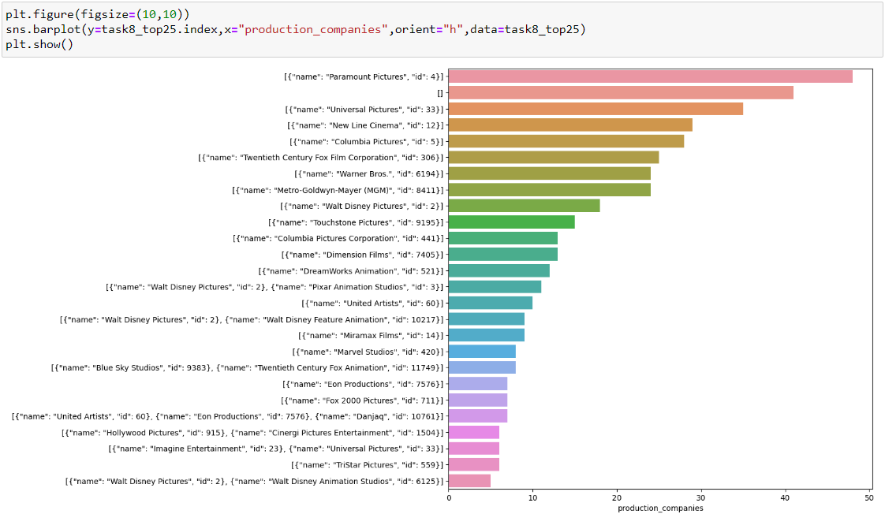

Slide 13
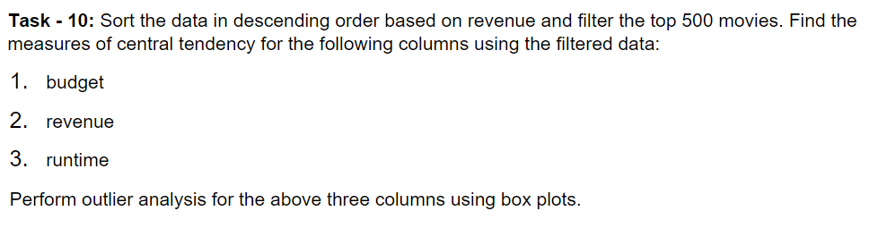

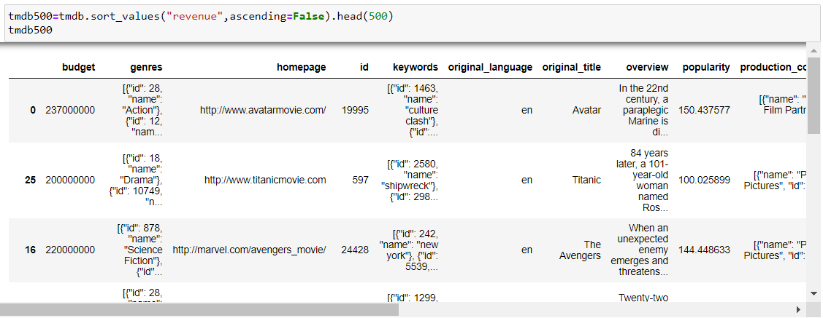
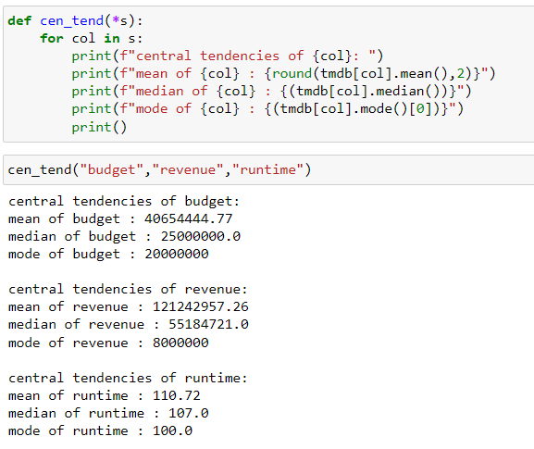
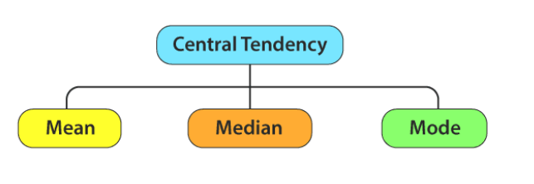

Slide 14

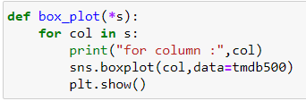
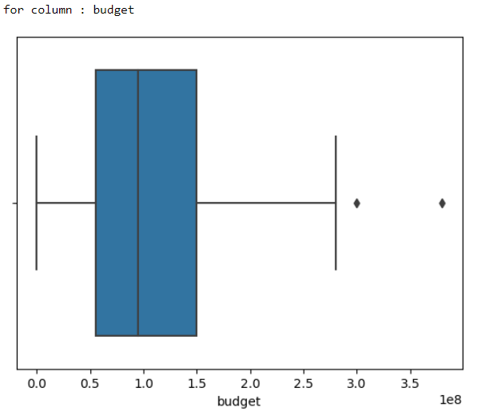
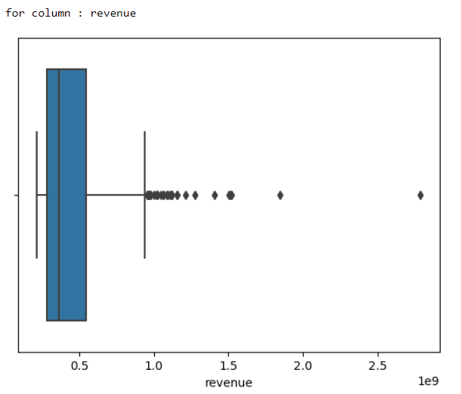
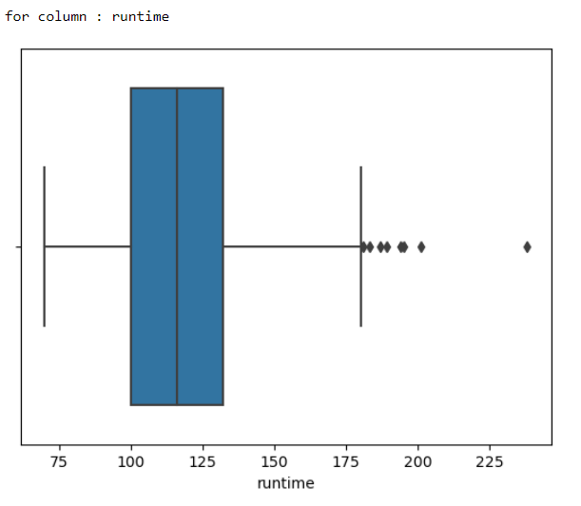
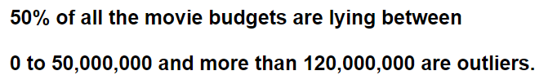
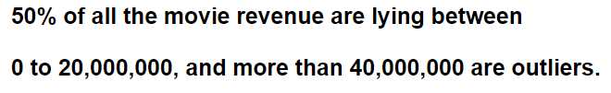
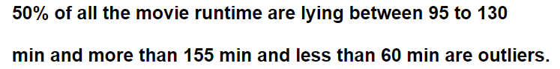

Slide 15
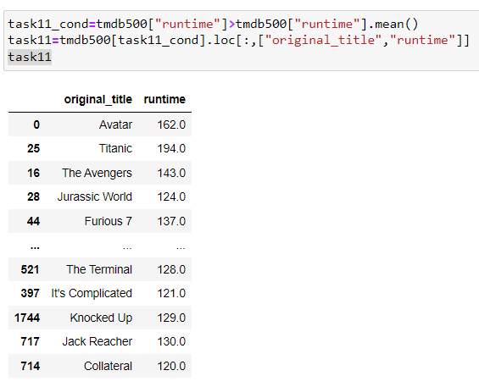


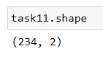
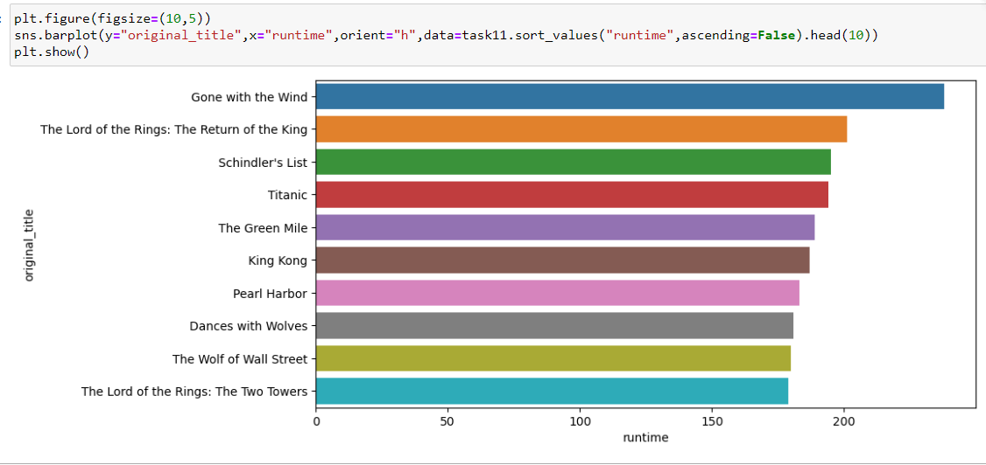
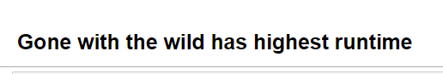
Number of records : 234

Slide 16
Summary
Adventure, Action and Fantasy have highest budget over all the movie categories.
Adventure, Action , Fantasy and Science fiction have highest revenue over all the movie categories.
Avatar movie has all-time highest revenue.
Modern Times movie is all-time lowest budget film.
Movie popularity and Budget have weak and positive correlation.
Paramount pictures production company has the highest number of movies (Around 48).
Gone with the wild movie has highest runtime among top 500 movies based on revenue.

Slide 17

Thank you

